Slide 1
README
BURN AFTER READING
about_SlideDeck
The actual presentation starts with slide 6 ("Session title"). The first five slides have a purely organisational purpose. During the break before your session, you should start the presentation with slide 2 ("Next up"), so that the audience knows that they are in the right room. It's fine if you start chatting with the audience during this break, but we need a precise starting point for your presentation in terms of editing your video. That means:
The recording of your presentation will start after the countdown. Please (RE)START talking after the countdown, not during it! Otherwise your recording will start with a half sentence.
It is not necessary to explicitly signal to the PA operator, this is your signal!
Finally, do you have to use this slide deck? No, you are free to present the way you like it. But you are asked to use the intro slides: countdown, session title, sponsor slide. Beyond that, use what is good for the cause – from no slides to sketches from your children, from Jupyter to $youNameIt.
You will find additional information in the notes below.
Sincerely, your hosts!
Dear Speaker, we are thrilled and honored to have you with us in Malmö in 2025. Take your time and read this before you prepare your session.
Since most of you have been with us before, you will already know a lot about PSConfEU. You know that we try to capture all sessions carefully and publish your work on YouTube. There are a few easily avoidable stumbling blocks that we would like to draw your attention to:
Your screen resolution should be 1920x1080 px (FullHD)
You should provide a full size HDMI socket
Mirror your screen
Disable "Presenter View" in PowerPoint
Using MAC or Surface book? Be aware of HDCP!
Disable the ‘Night light mode’
Notes:
The fine print (additional information)
Why should you care about HDCP?
"High-bandwidth Digital Content Protection (HDCP) is a form of digital copy protection developed by Intel Corporation to prevent copying of digital audio and video content as it travels across connections. Types of connections include DisplayPort (DP), Digital Visual Interface (DVI), and High-Definition Multimedia Interface (HDMI), as well as less popular or now deprecated protocols like Gigabit Video Interface (GVIF) and Unified Display Interface (UDI)."
https://en.wikipedia.org/wiki/High-bandwidth_Digital_Content_Protection
Some notebooks ignore the HDCP standard, some vendors comply with the standard. Apple and Microsoft are somehow famous for strictly following the HDCP guidelines. Sadly, we will not be able to guarantee, that your session can be recorded in the latter case.
But you can do simple things, to overcome these problems. It is also very likely that you presented with your notebook before. So you will know, if this worked fine.If you are in doubt and if the agenda allows, try a dry-run a day before and connect everything.
In general you can easily bypass HDCP restrictions with a cheap splitter (the cheaper the better), just like the one you see below. This is an example device that we bought for 16 euros (in Germany).
Ask us, we will lend you such a device.
Thorsten also gave a whole presentation about "Broadcasting yourself" - easy steps to record yourself and create a (backup) session recording on your own. If you want to invest your time and dive deeper, take a look at his recordings and notes:
https://vimeo.com/thorstenbutz/byourself
This is of course completely voluntary, but perhaps you will find it helpful.

Slide 2
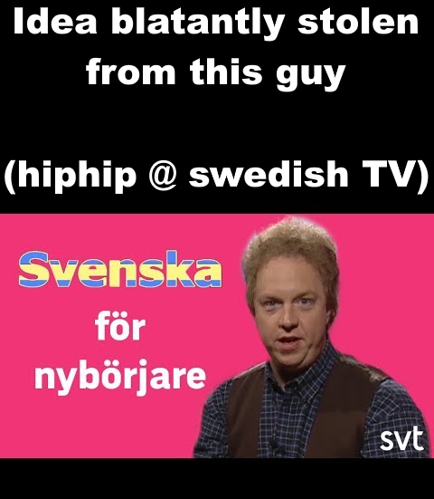
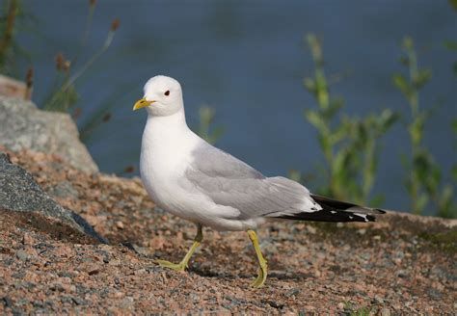

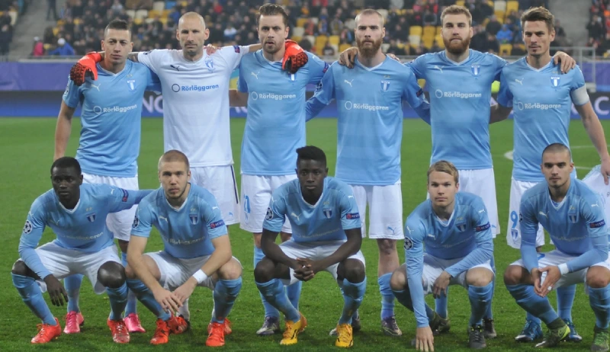
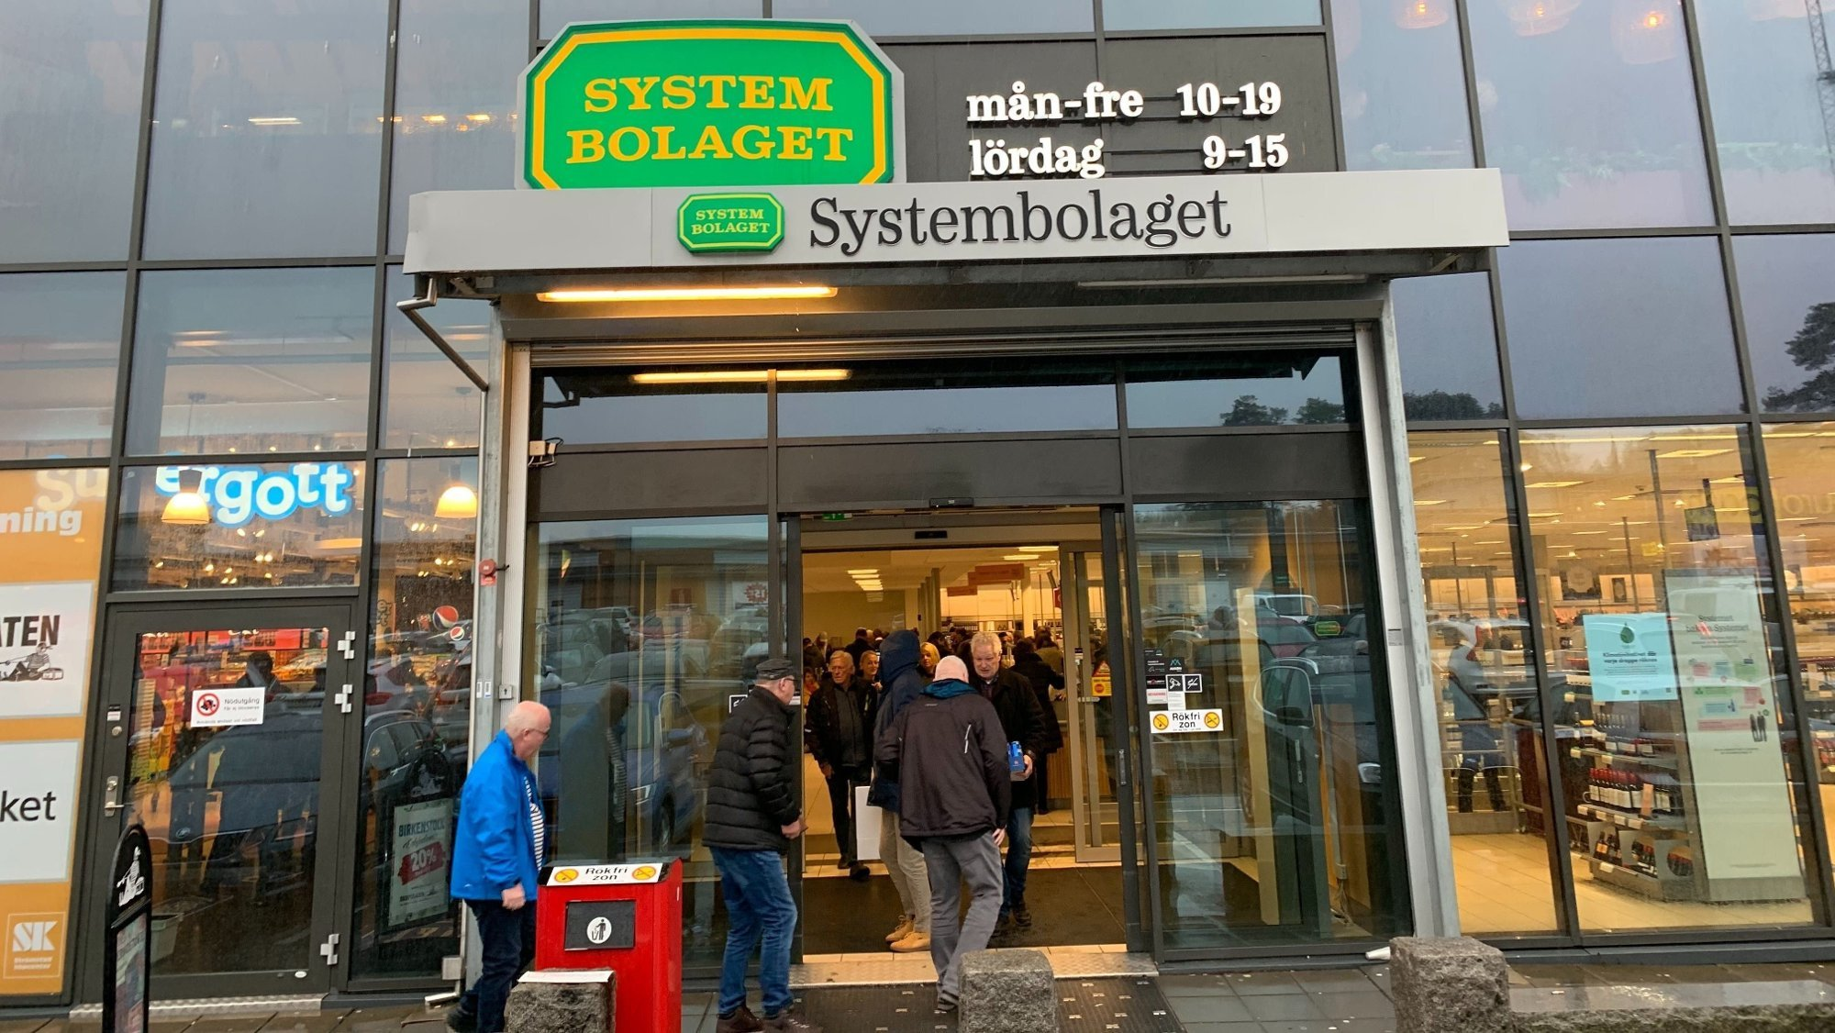
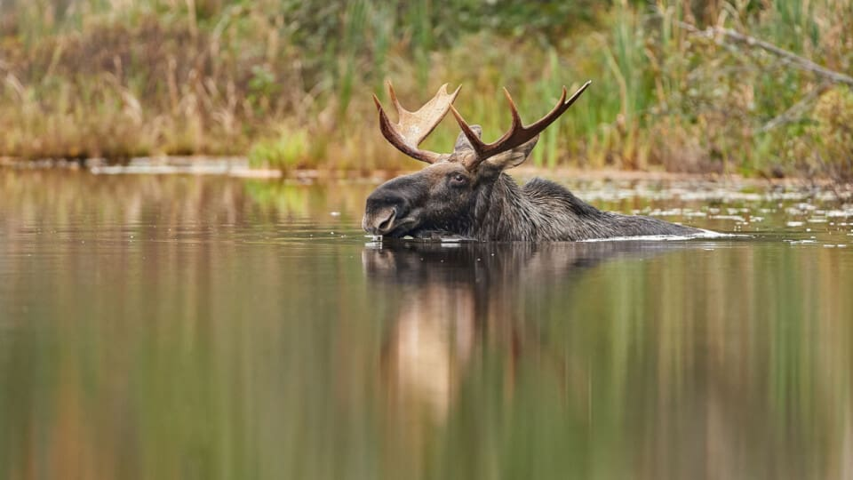
Saveinskaw fur neebewrjere - Swedish for beginners
Ein feesk maws
A Seagull
Gaw teel boo law get
Go to the liquor store
Ell Jen baw-durr
The elk is taking a bath
Mawl-mews fout-bawls log
Malmös football team
Few-rah stew-raw star-kewl
Four pints of lager

Slide 3
Next Up:
Björn Sundling

Slide 4
3
3

Slide 5
2

Slide 6
1

Slide 7
TDD for the PS1 DEV
Björn Sundling

Slide 8

Many thanks to our sponsors:

Slide 9
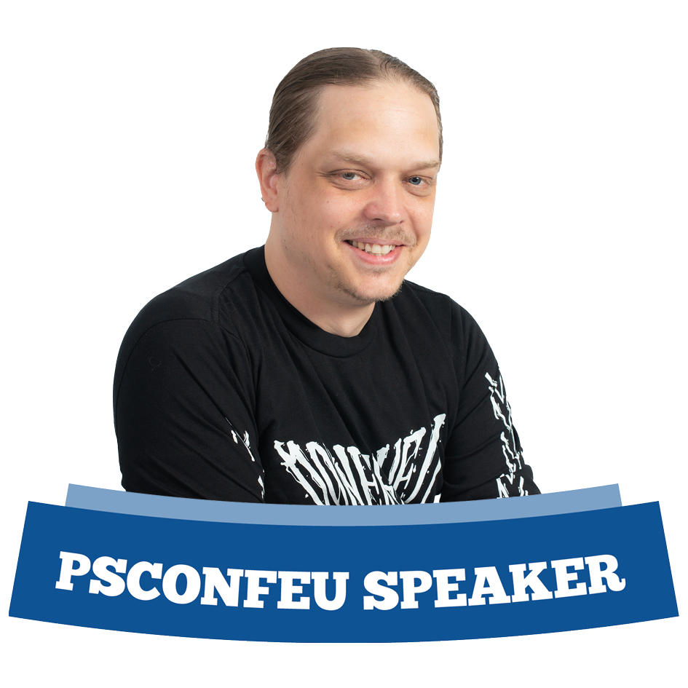
Björn Sundling
MVP, MCT, And lots of other cool titles.
Consultant @ Knowledge Factory, Advania
DevOps nerd, PowerShell afficionado, Dog walker, Black metal listener…

Slide 10
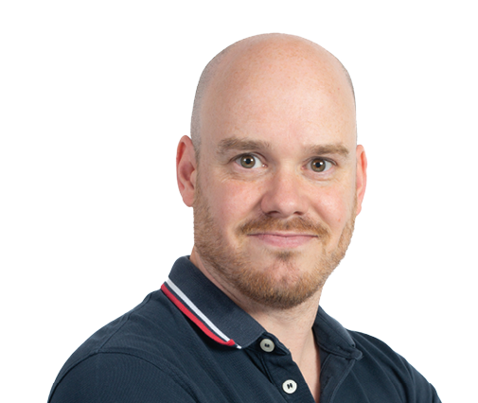
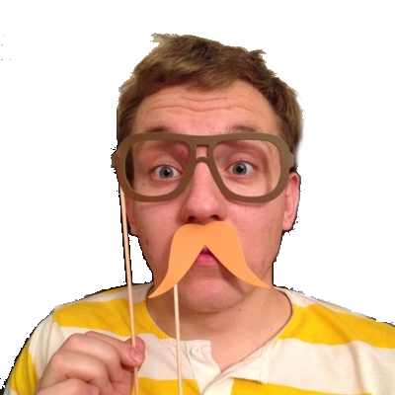
Agenda?
Test Driven Development
-Not Pester.
-Not folder structures

Slide 11
What is TDD?
Test Driven Development
Tests first
Minimal tests
Unit tests!

Slide 12
What is (almost) TDD?
BDD
Behaviour Driven Development
Describes the user behaviour – Gherkin
Given -> When -> Then
Testcases – But not necessarily unit tests or code even!
DDD
Domain Driven Design
Focus on how the domain works and connects
Not really tests..

Slide 13

How to TDD?
Red
Green
Refactor
Get coffee

Slide 14
Demos
Red
Green
Refactor
Notes:
Red –> green -> refactor demo
Demo1

Slide 15
A bit about Pester…
Describe -> Context -> It
Mocks
Should
-Be
-Not
-HaveParameter

Slide 16

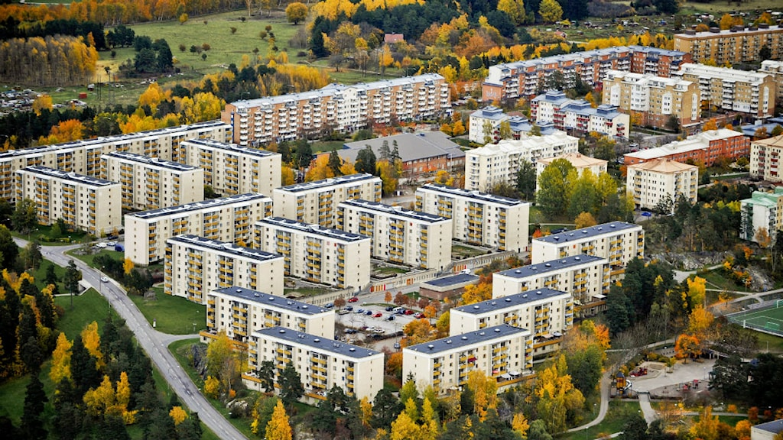
Bjompens guide to TDD – Good stuff.
Snickarglädje
Know your audience
99% of snickarglädje is actually useless..
Know your API!
Explorative test files
Build -> destroy -> rebuild

Slide 17
Demos
Know
Your
API

Slide 18
Bjompens guide to TDD - Parameters
Parameters
Red -> Red -> Red -> Red -> Red -> Green
Use parameters for versioning!

Slide 19
Demos
Parameters

Slide 20

Bjompens guide to TDD – Writing testable code.
Separation of concerns
Avoid tight couplings
One function -> one thing!
Wrappers! Wrappers! Wrappers!

Slide 21
Demos
ADOPS time!

Slide 22
Additional testing – TDD for module building
Technically not TDD
But why repeat tests?
Module.Tests.ps1
Pass ScriptAnalyzer rules
Only export public functions
Have approved verbs
Casing, PascalCase and camelCase
Have documentation (.md)
Have matching .Tests.ps1 file! (don’t cheat on testing!)

Slide 23
Demos
We love Demos!
Notes:
Demo ADOPS – Module testing

Slide 24
Additional testing – TDD for non greenfield projects
Add tests for bugs
Break out functionality to internal / helper functions
And add test for those.. Duh..

Slide 25
Demos
We love Demos!
Notes:
Leave a message for tomorrow – a red test
Start the day by seeing “Oh, this was what I was supposed to solve!”
Add a test for “Potato”

Slide 26
Bjompens guide to TDD – Now what?

Slide 27
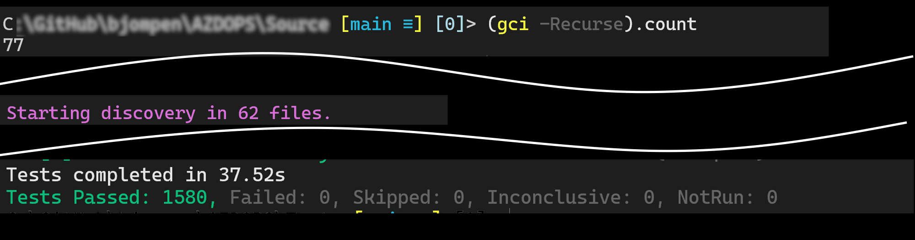
Lessons learned..
It is OK to cheat – BUT NOT ON RED!
Write small – it is easier
Don’t aim for 100% coverage – Some things does not make sense to test.
Hashtables are messy - [ordered] is your friend in the API testing world!
Never forget what you were working on!
Leave a message for tomorrow – a red test
Start the day by seeing “Oh, this was what I was supposed to solve!”

Slide 28
Q&A
15 minutes

Slide 29
Instructions
Use this template if you want, it’s preferred but not mandatory.
Please make sure our sponsors are mentioned on your first slide after the title.
Do not amend the ratio or the colours of the sponsors’ logo and background.
Update your twitter handle through the master page (see next slides).

Slide 30
Instruction (Continued)
The session is 30 min.
Then 15min Q&A.
At the end of your 45 min, please leave the room to the next speaker.
You’re welcome to continue the discussion in the Foyer area.

Slide 31
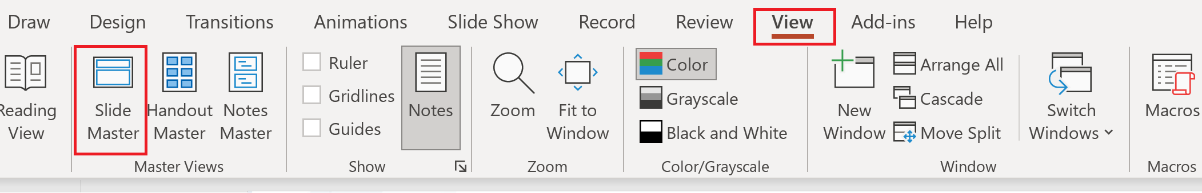
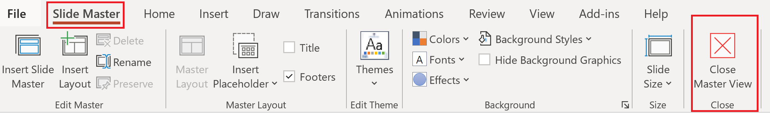
Update the twitter handle on the master slide
To open the slide master:
To close the Master view:
If you need any help, do not hesitate to email us at psconfeu@synedgy.com

